Slide 1
BMEG3105-Introduction to Python Packages
Yixuan Wang(王艺璇)
Friday, September 16, 2022
yxwang@cse.cuhk.edu.hk
Department of Computer Science and Engineering (CSE)
The Chinese University of Hong Kong (CUHK)

Slide 2
Outline
Packages management in Colab
Virtual environment creation in Anaconda
Introduction to biopython

Slide 3
Packages management in Colab
https://colab.research.google.com/drive/1f260uDCsl5vAwPttQwNLfpWAaq7kXvtY?usp=sharing
https://www.youtube.com/watch?v=9Q9Lq5rwGZg

Slide 4

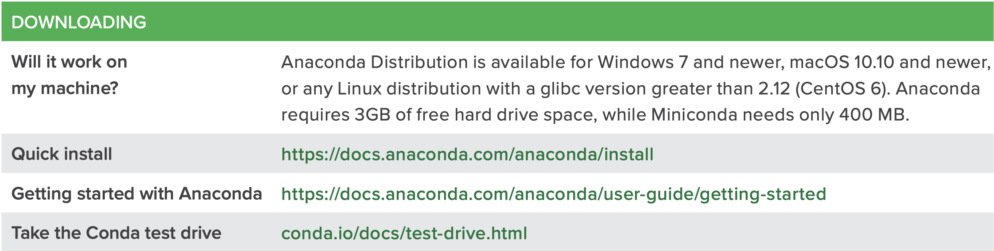
Overview of Anaconda
Anaconda is a distribution of the Python and R programming languages for scientific computing (data science, machine learning applications, large-scale data processing, predictive analytics, etc.), that aims to simplify package management and deployment. The distribution includes data-science packages suitable for Windows, Linux, and macOS.
https://docs.anaconda.com/anaconda/user-guide/cheatsheet/
Notes:
Will upload the starter guide later.

Slide 5
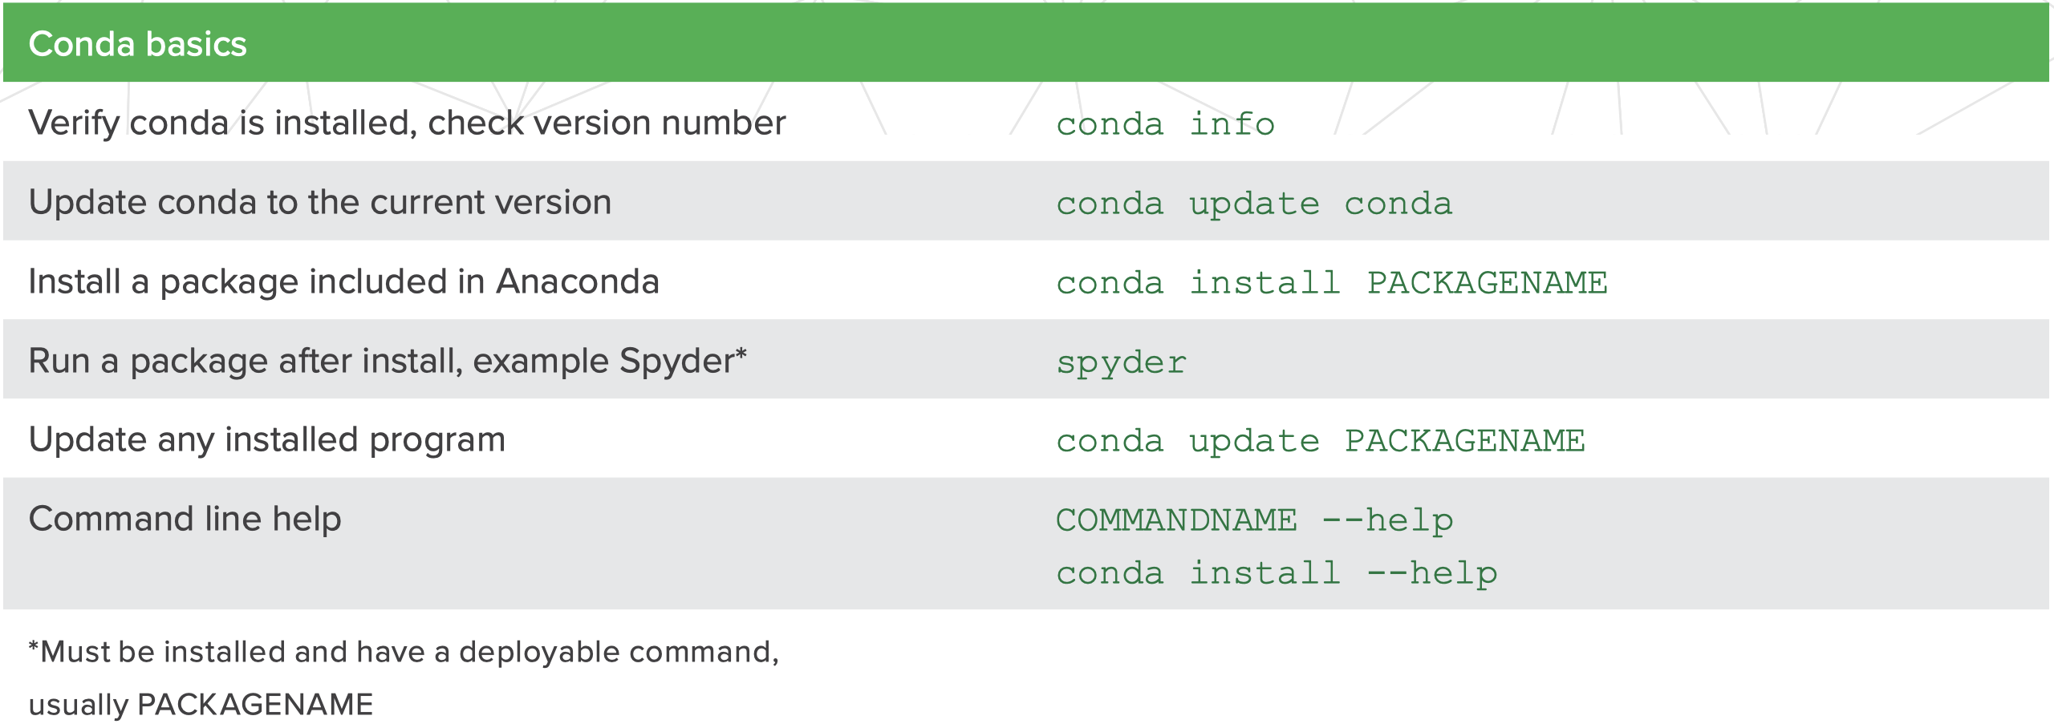
Overview of Anaconda
To check if you have successfully installed conda:
Anaconda.org

Slide 6
Virtual environment creation in Anaconda
What is Virtual Environment?
A virtual environment is a tool that helps to keep dependencies required by different projects separate by creating isolated python virtual environments for them.
Why do we need a Virtual Environment?
Imagine a scenario where you are working on two python projects and one of them uses python 3.9 and the other uses python 3.6. In such situations virtual environment can be useful to maintain dependencies of both the projects.
Anaconda.org

Slide 7
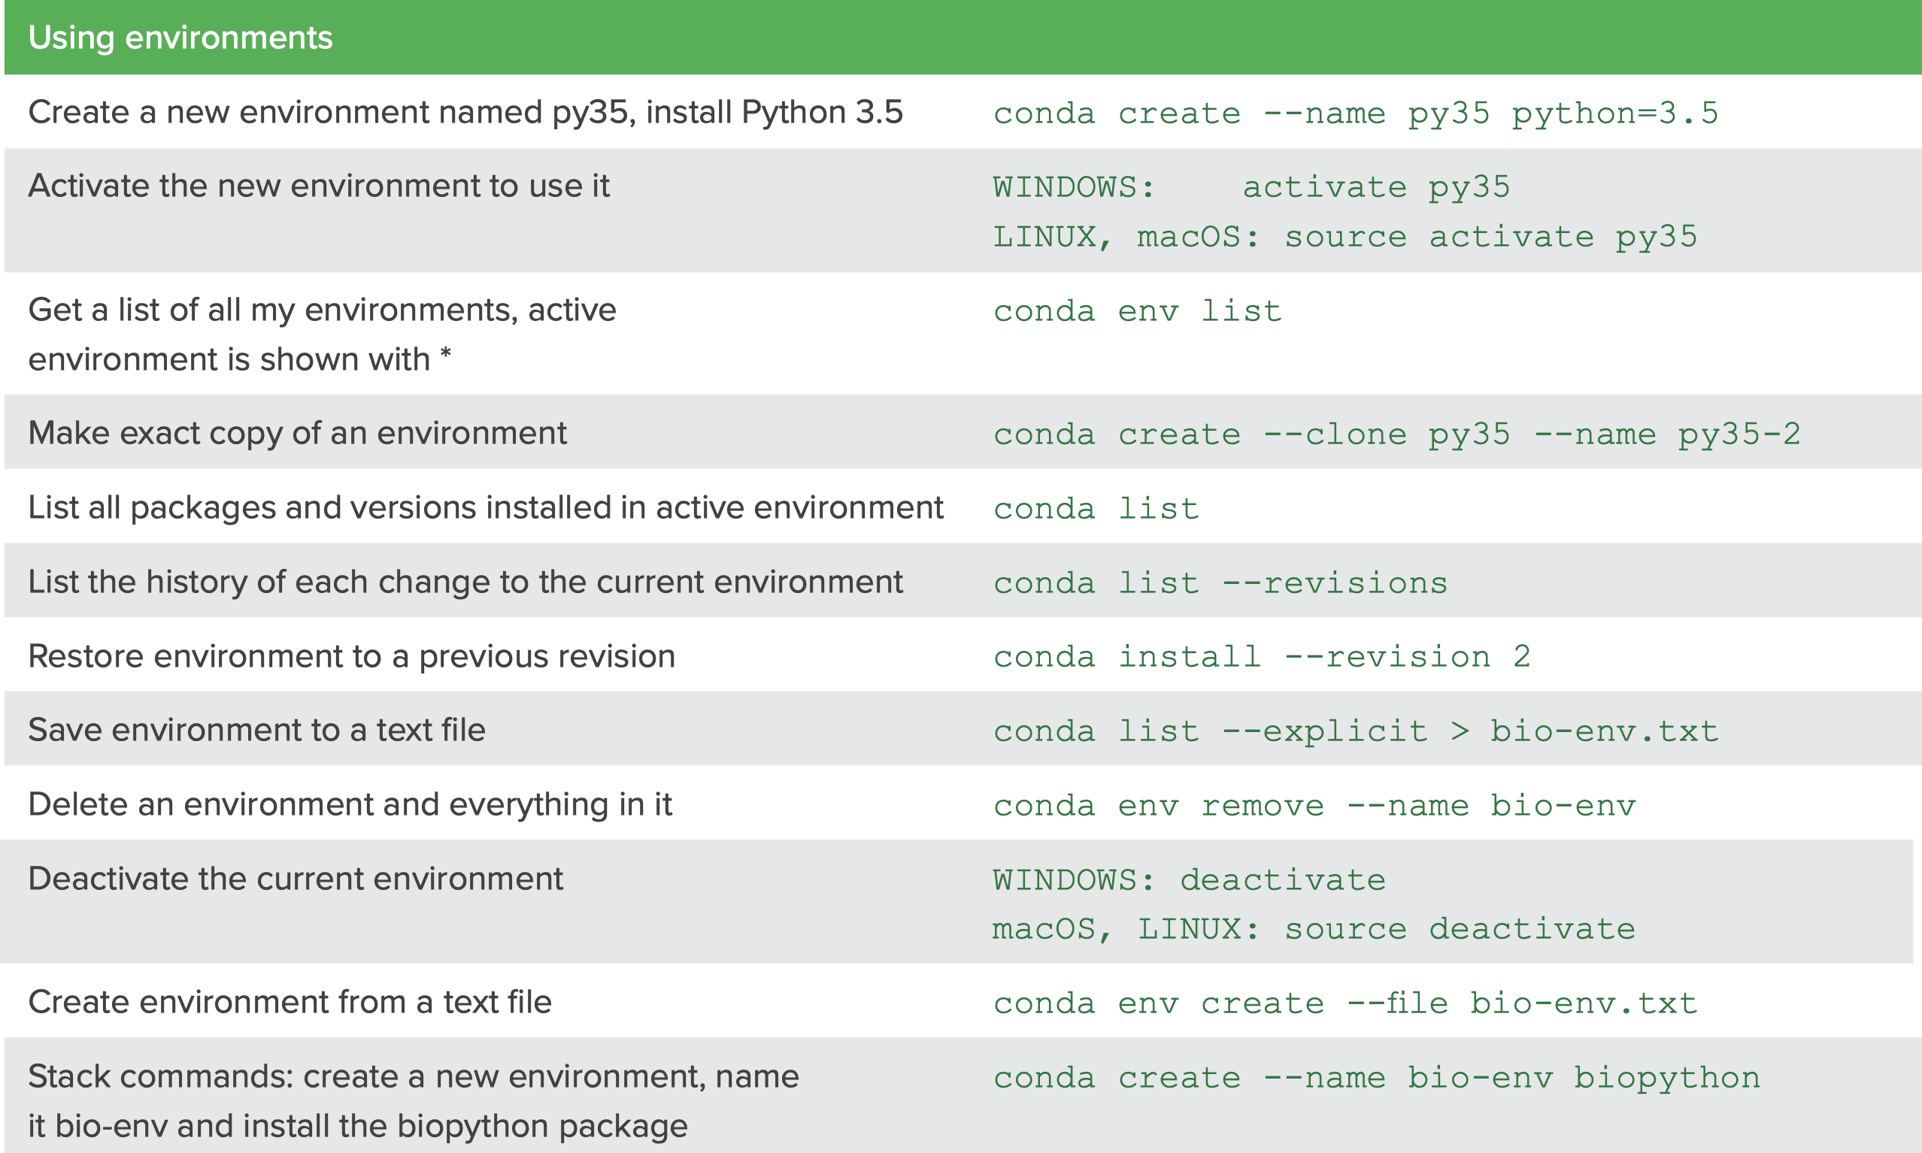
Virtual environment creation in Anaconda
Anaconda.org

Slide 8
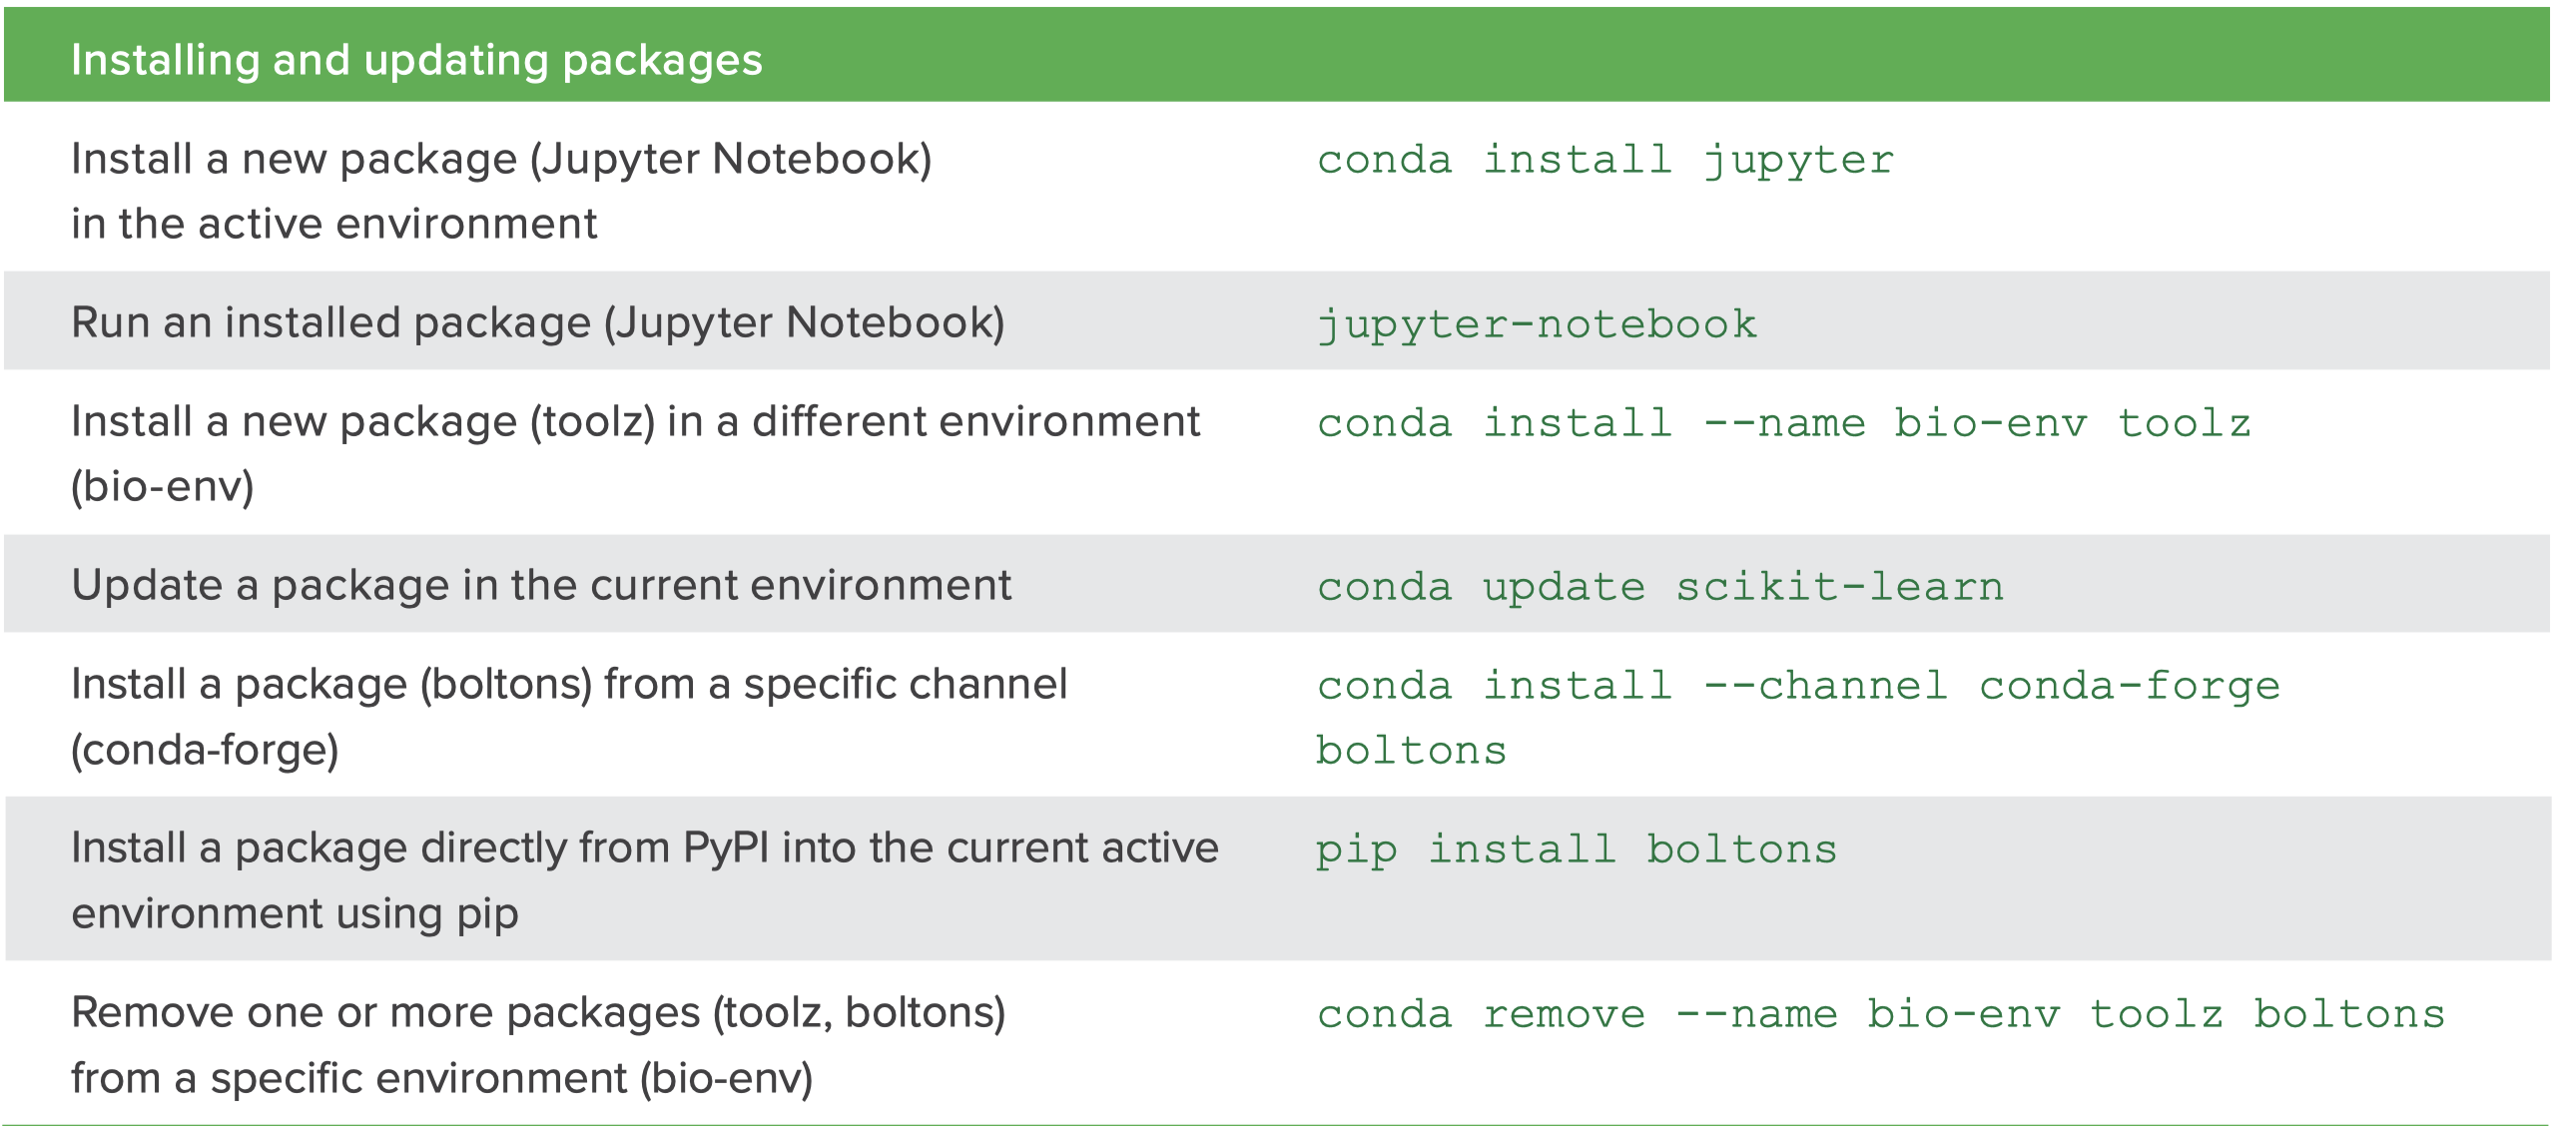
Virtual environment creation in Anaconda
Anaconda.org

Slide 9
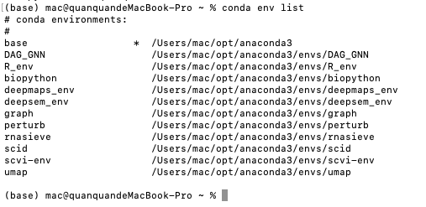
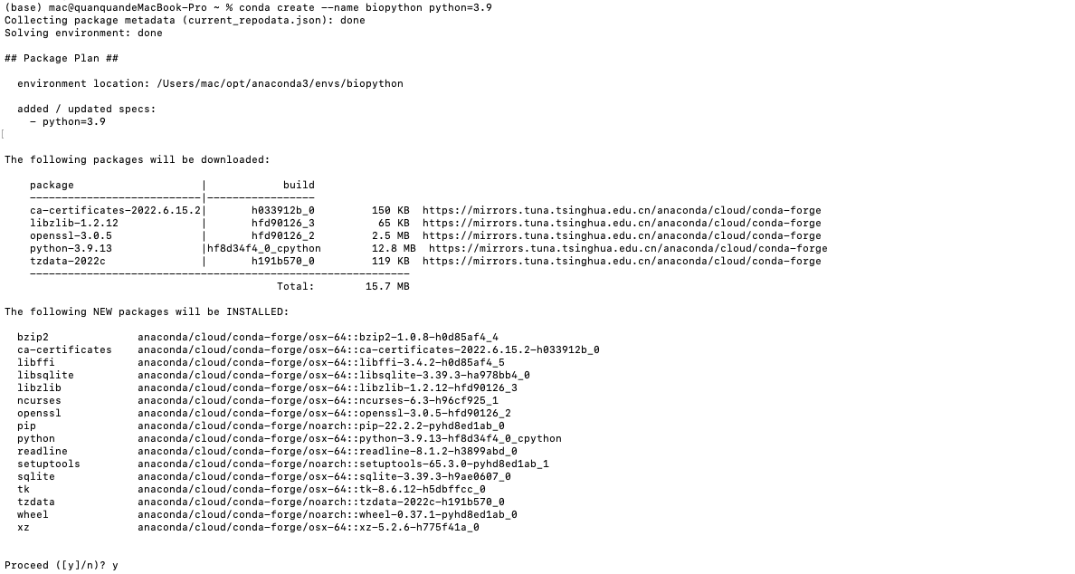
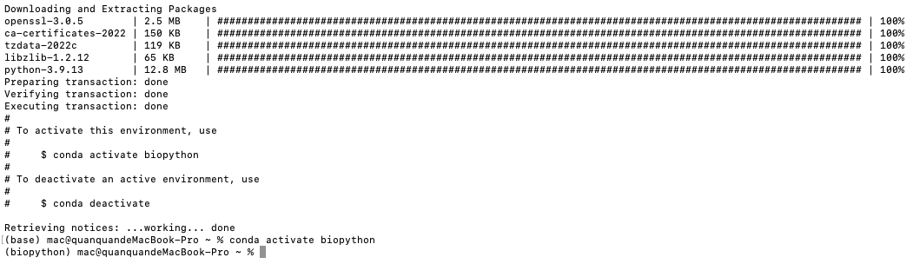
Virtual environment creation in Anaconda
conda create - -name biopython python=3.9
conda activate biopython
conda env list
Anaconda.org

Slide 10
Virtual environment creation in Anaconda
To find more packages, visit: https://anaconda.org
Anaconda.org

Slide 11
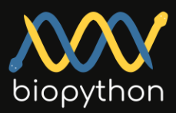
Introduction to biopython
Biopython is a set of freely available tools for biological computation written in Python by an international team of developers.
https://colab.research.google.com/drive/1-W5ZySU0_HwrG99Jzh32xurGhuX7c7YZ?usp=sharing
Anaconda.org

